Slide 1
Korukonda chandu
Final Project
06/14/2024 Annual Review

Slide 2
PROJECT TITLE
KEYLOGGER and SECURITY
06/14/2024 Annual Review

Slide 3



AGENDA
A keylogger is a key stroker/keyboard capturing is a form of malware or hardware that keeps track of and records your keystrokes as you type.
It takes the information and sends it to a hacker using a command-and-control (C&C) server.
The hacker then analyzes the keystrokes to locate usernames and passwords and uses them to hack into otherwise secure systems.
3/21/2024 Annual Review

Slide 4

PROBLEM STATEMENT
Keylogger Threats
Keyloggers pose a serious security risk by secretly recording a user's keyboard input, potentially exposing sensitive information like passwords and financial data.
Lack of User Awareness
Many users are unaware of keylogger threats or lack the knowledge to effectively safeguard their devices and online activities.
Inadequate Security Measures
Existing security solutions may not provide comprehensive protection against sophisticated keylogger attacks, leaving users vulnerable.
06/14/2024 Annual Review

Slide 5

PROJECT OVERVIEW
Objective:
Develop a comprehensive understanding of keyloggers,
their types, how they work, and effective security measures to prevent keylogging attacks.
Scope:
Includes an analysis of hardware and software keyloggers, legal and ethical implications, security measures, and best practices
06/14/2024 Annual Review

Slide 6

WHO ARE THE END USERS?
Keyloggers and security measures can be utilized by various entities for different purposes:
Individuals:
Businesses and Organizations:
Government Agencies:
Cybercriminals:
Security Professionals
06/14/2024 Annual Review

Slide 7

YOUR SOLUTION AND ITS VALUE PROPOSITION
Solution:
Implement a multi-layered security strategy that includes anti-keylogging software, regular system scans, software updates ,and user education.
Value Proposition:
Enhanced Security: Reduces the risk of data breaches and
identity theft.
User Awareness: Educates users about keylogging threats and
protection methods.
Compliance: Helps businesses and organizations comply with
data protection regulations.
06/14/2024 Annual Review

Slide 8

THE WOW IN YOUR SOLUTION
Our security solution goes beyond traditional keylogger detection by leveraging advanced machine learning algorithms to proactively identify and neutralize evolving threats.
This cutting-edge technology provides unparalleled protection, delivering a seamless user experience without compromising security.
3/21/2024 Annual Review
8

Slide 9
MODELLING
•Start:
The program begins its execution.
•Intercept Keystrokes:
The keylogger intercepts keystrokes entered by the user.
•Log Keystrokes:
The intercepted keystrokes are logged.
•Store Keystrokes:
The logged keystrokes are stored, usually in a local file or memory.
•Optional:
• Transmit Keystrokes:
Optionally, the logged keystrokes may be transmitted to a remote server for storage or further analysis.
•End:
The program finishes its execution.
06/14/2024 Annual Review
9

Slide 10
MODELLING
Flow Diagram:
Initialization:
üSet up the main GUI window.
üInitialize global variables for key logging.
Event Capture:
üStart capturing key events when the "Start" button is pressed.
üLog key press and release events.
Data Logging:
üContinuously update text and JSON log files with captured key events.
Stop Logging:
üStop capturing key events when the "Stop" button is pressed.
üUpdate the GUI status to indicate the keylogger is stopped.

Slide 11
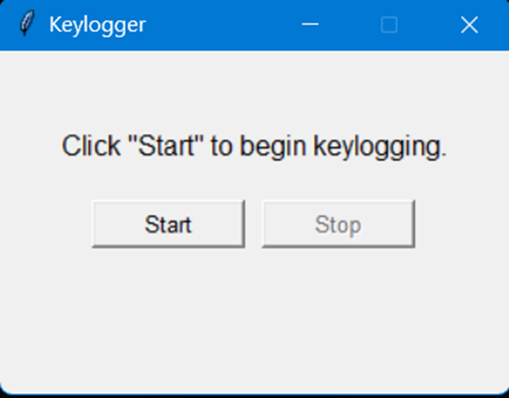
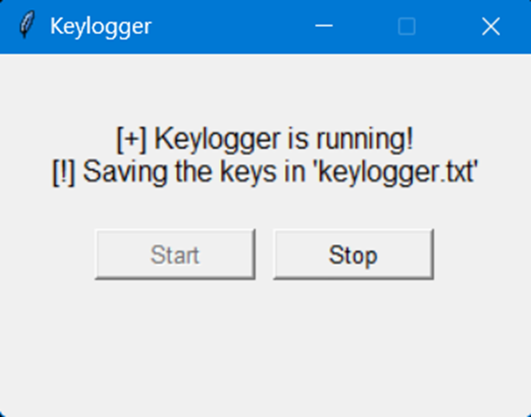
RESULTS
The result of a keylogger program typically involves capturing and logging keystrokes entered by a user on a keyboard.
These logged keystrokes can then be used for various purposes, depending on the intent of the keylogger user.
The covert nature of keyloggers allows them to capture sensitive information, including passwords, personal messages, and financial details, without the user's knowledge or consent.
This poses serious risks to individuals, organizations, and society at large, including identity theft, financial fraud, and unauthorized access to confidential data
06/14/2024 Annual Review
11

Slide 12
PROJECT LINK

